Slide 1

An Online Framework for User-Based Analysis of Maps in First Person Shooters

Slide 2

What makes a video game good?
Visuals, narrative and gameplay.
Game Design
Level Design
Gameplay

Slide 3
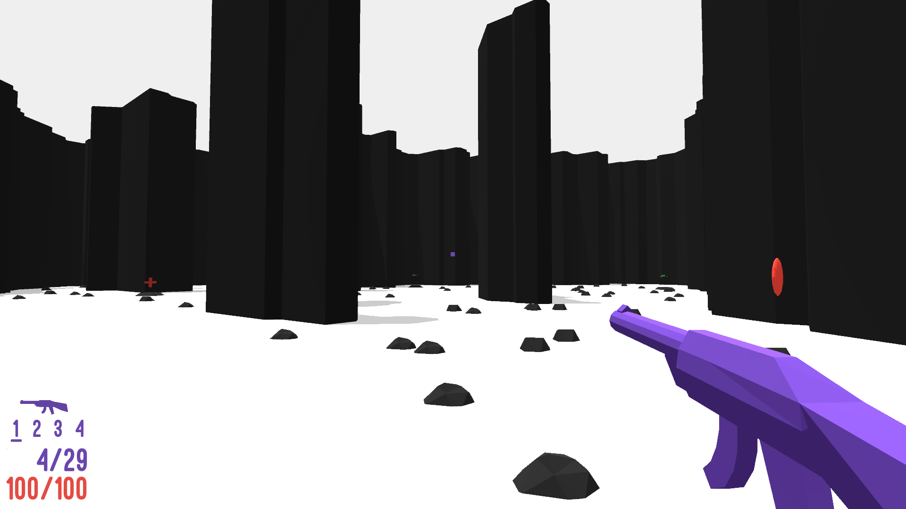

Slide 4
Research in Level Design
Two main fields:
Formalization of the discipline
Support to the design process
Many works use Procedural Content Generation to support the design process.
The majority of these works are based on data collected from simulations.

Slide 5
Map design and generation framework
Developed to be modular, parametric and online.
Broad support to existing formats.
Easy deployment of browser playable experiments.

Slide 6

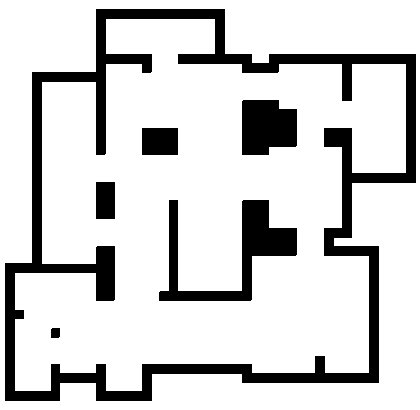

Map generation
Cellular generator
Divisive generator
Digger generator

Slide 7
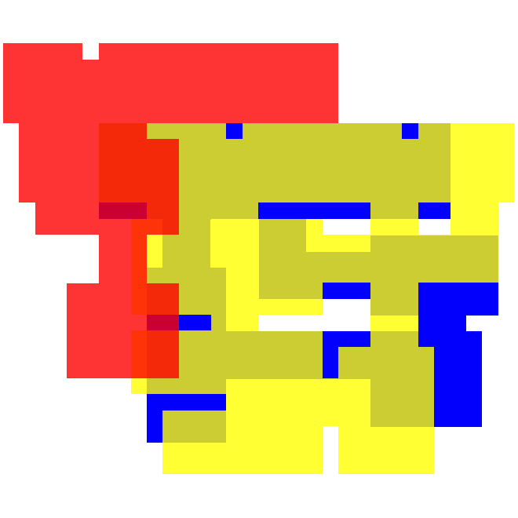
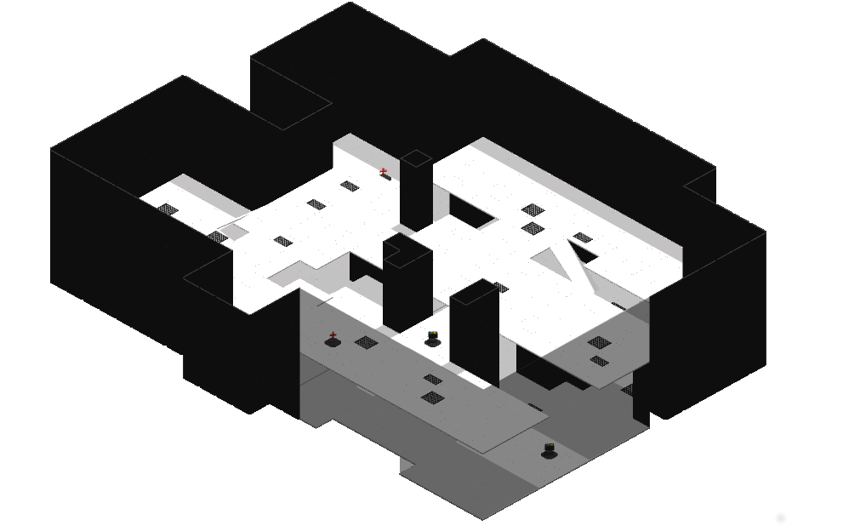
Multi-level maps
More complex multi-level maps than the ones produced in previous works.

Slide 8
Graph-based map analysis
Generate different graphs highlighting different features of the map.
Extract layout information using Graph-Theory metrics.
Use this information to analyze the map or to place game elements.

Slide 9

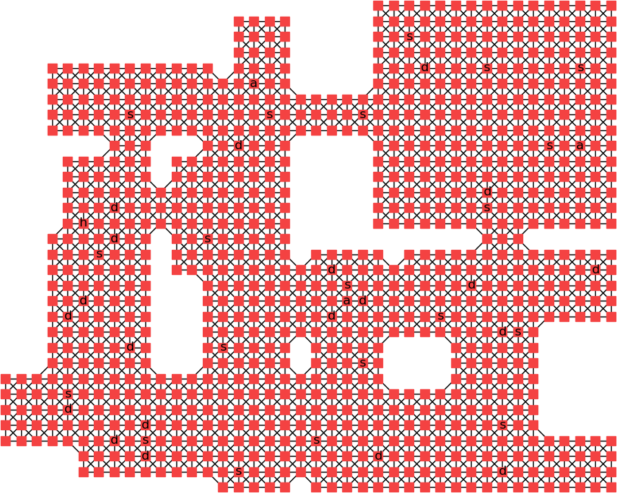
Graphs for single-level maps
Map
Tiles graph

Slide 10
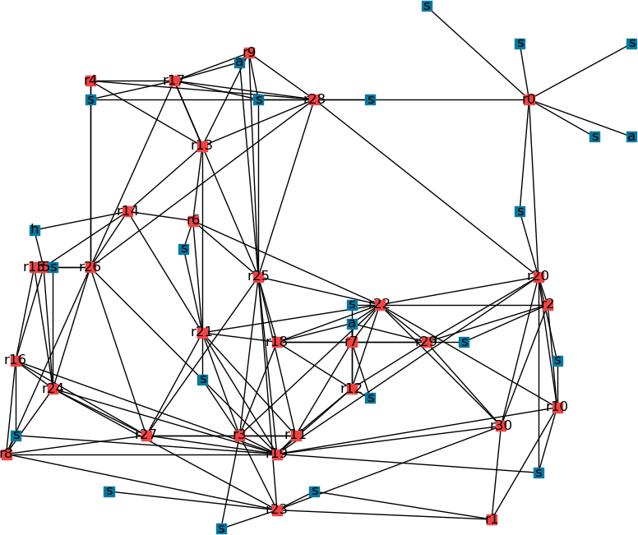
Graphs for single-level maps
Map
Rooms and game elements graph

Slide 11
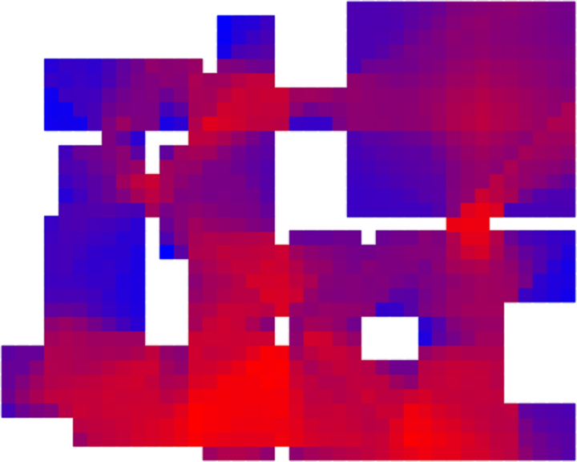
Graphs for single-level maps
Map
Visibility graph

Slide 12
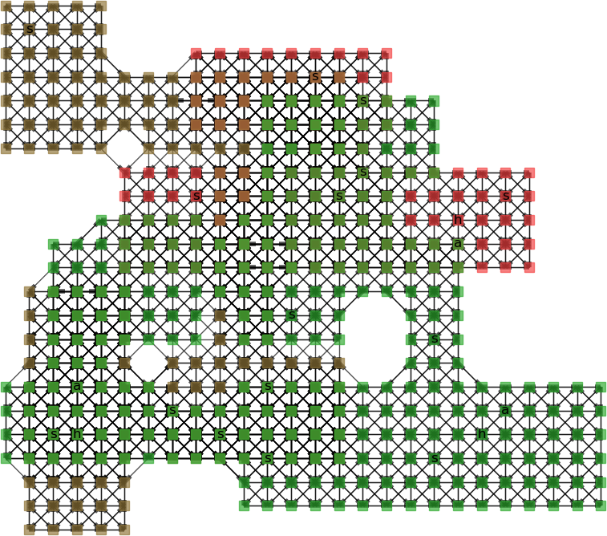
Graphs for multi-level maps
Map
Tiles graph

Slide 13
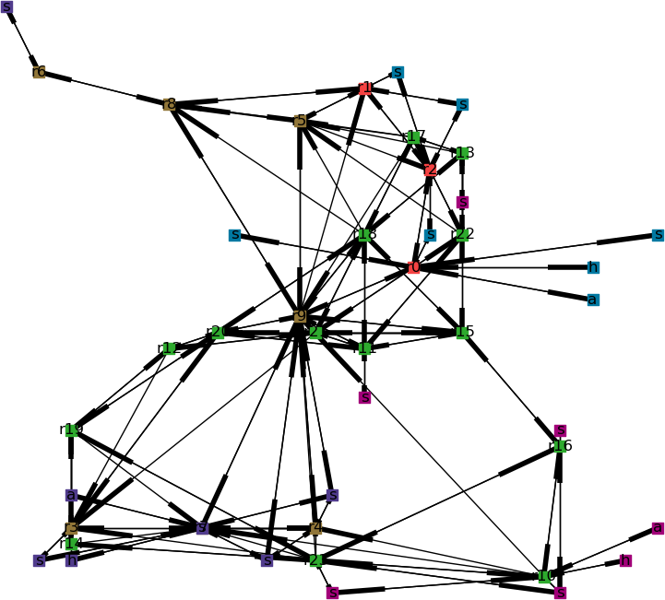
Graphs for multi-level maps
Map
Rooms and game elements graph

